Slide 1


Let’s Get Optimising
Workshop Outcomes & Deliverables
May 2021

Slide 2
Baseline Overview
Based on our research, we have identified that shwallacemarine.com.au website contents are not properly optimised for search engines. Google and other search engines might penalize your website that will result to low ranking score or will not be visible to search engines at all. Keywords are need to be refocused and optimised to drive traffic from your target market.
To address this, we will be executing a complete website audit to evaluate your website health performance and review key messaging, tone, industry jargon, layout and structure of content. We will identify new opportunities to address our key target market and create a content strategy to bring the website up to date.
The new content strategy will specifically address the Target Market ‘______’ and identify the following key areas:
• The key problems associated with the target market
• The key solutions associated with the target market
• Building trust and credibility in the form of customer testimonials, citations and case studies
• A call to action that gets online customers to convert on either a) the sign up/contact page or b) ring to book in a free showroom consult.

Slide 3
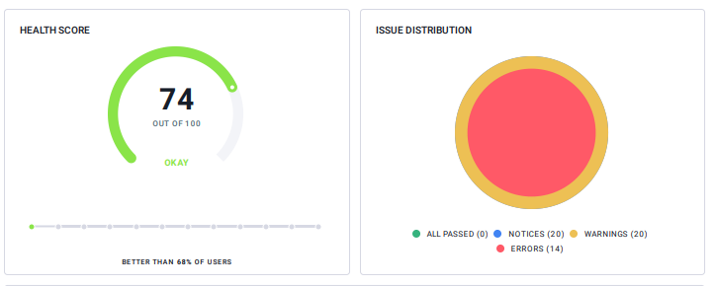
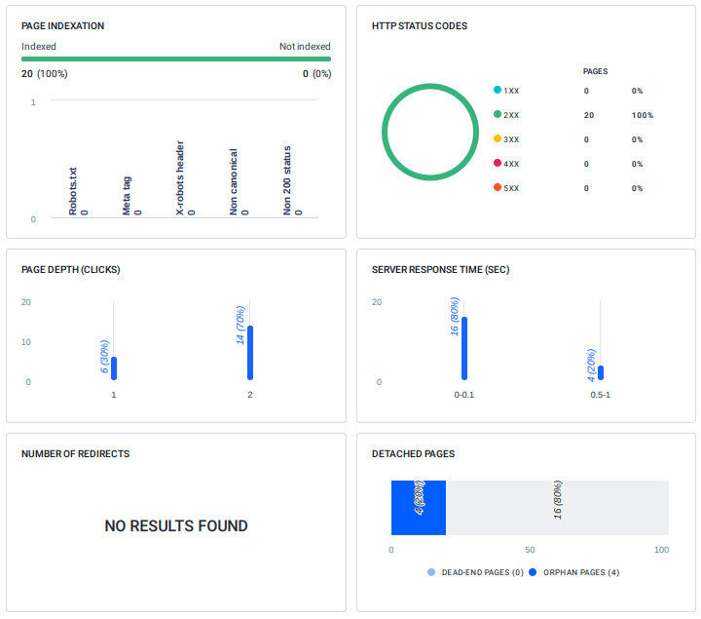
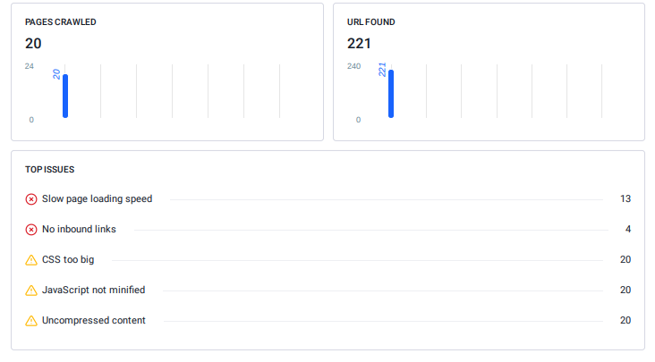
Baseline Report
Website Audit

Slide 4
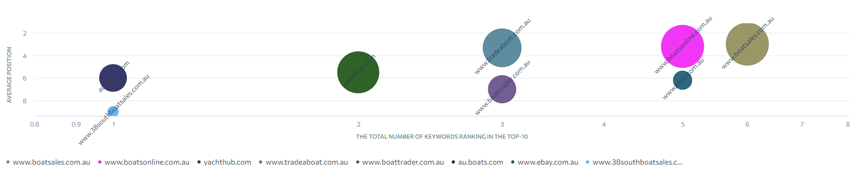
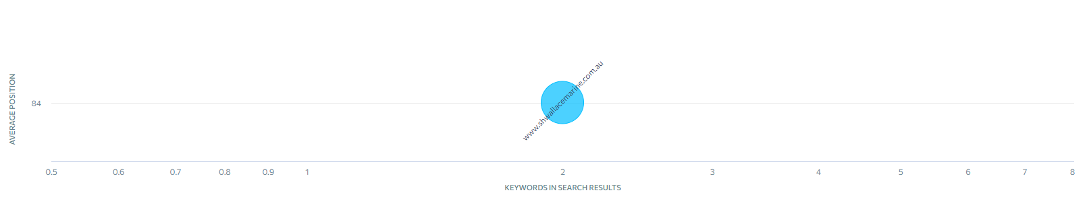
Baseline Report
Average Ranking Position
SH Wallace Marine average position vs organic competitors.

Slide 5
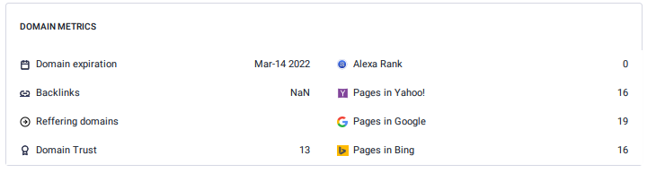
Baseline Report
Domain Metrics

